Slide 1
Dynamic Programming continued

Slide 2
Longest increasing subsequence
Given a sequence of numbers X = x₁, x₂, …, x_{n} find the longest increasing subsequence
(i₁, i₂, …, i_{k}), that is a subsequence where numbers in the sequence increase.
5 2 8 6 3 6 9 7

Slide 3
Longest increasing subsequence
Given a sequence of numbers X = x₁, x₂, …, x_{n} find the longest increasing subsequence
(i₁, i₂, …, i_{k}), that is a subsequence where numbers in the sequence increase.
5 2 8 6 3 6 9 7

Slide 4
Step 1: Define the problem with respect to subproblems
Longest increasing sequence for X is the longest
increasing sequence starting at any element

Slide 5
Step 2: build the solution from the bottom up
5 2 8 6 3 6 9 7

Slide 6
Step 2: build the solution from the bottom up
1
5 2 8 6 3 6 9 7

Slide 7
Step 2: build the solution from the bottom up
1 1
5 2 8 6 3 6 9 7

Slide 8
Step 2: build the solution from the bottom up
1 1
5 2 8 6 3 6 9 7

Slide 9
Step 2: build the solution from the bottom up
2 1 1
5 2 8 6 3 6 9 7

Slide 10
Step 2: build the solution from the bottom up
3 2 1 1
5 2 8 6 3 6 9 7

Slide 11
Step 2: build the solution from the bottom up
2 3 2 1 1
5 2 8 6 3 6 9 7

Slide 12
Step 2: build the solution from the bottom up
2 2 3 2 1 1
5 2 8 6 3 6 9 7

Slide 13
Step 2: build the solution from the bottom up
4 2 2 3 2 1 1
5 2 8 6 3 6 9 7

Slide 14
Step 2: build the solution from the bottom up
3 4 2 2 3 2 1 1
5 2 8 6 3 6 9 7

Slide 15
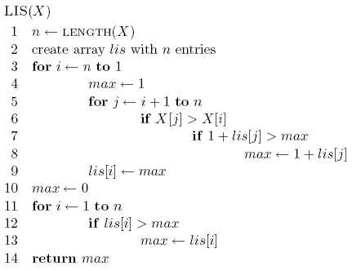
Running time?
Θ(n²)

Slide 16
Another solution
Can we use LCS to solve this problem?
5 2 8 6 3 6 9 7
LCS
2 3 5 6 6 7 8 9

Slide 17
Another solution
Can we use LCS to solve this problem?
5 2 8 6 3 6 9 7
LCS
2 3 5 6 6 7 8 9

Slide 18
Quick summary
Step 1: Define the problem with respect to subproblems
  We did this for divide and conquer too. What’s the difference?
  You can identify a candidate for dynamic programming if there is overlap or repeated work in the subproblems being created
Step 2: build the solution from the bottom up
  Build the solution such that the subproblems referenced by larger problems are already solved

Slide 19
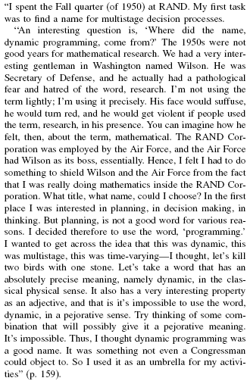
Where did “dynamic programming” come from?
Richard Bellman On the Birth of Dynamic Programming
Stuart Dreyfus
http://www.eng.tau.ac.il/~ami/cd/or50/1526-5463-2002-50-01-0048.pdf

